Slide 1
Chapter 5
Systems Analysis

Slide 2
Definitions
Systems Analysis
  a problem-solving technique that decomposes a system into its component pieces to study how well those component parts work and interact to accomplish their purpose
Systems Design
  a problem-solving technique that re-assembles the components back into an improved system by adding, deleting, and changing pieces relative to the original system

Slide 3
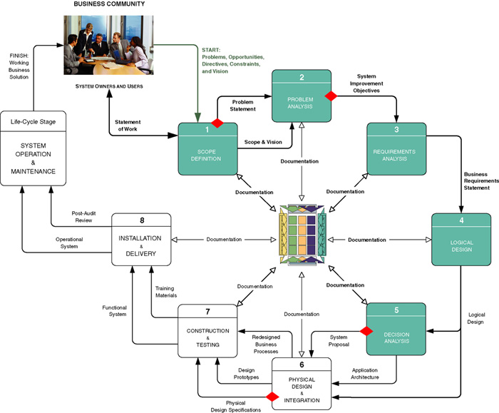
The Context of System Analysis

Slide 4
The Context of System Analysis
Phase 1 Scope Definition
Phase 2 Problem Analysis
Phase 3 Requirements Analysis
Phase 4 Logical Design
Phase 5 Decision Analysis

Slide 5
Phase 1 Scope Definition
Task 1.1 Identify Problems and Opportunities
Task 1.2 Negotiate Scope
Task 1.3 Assess Project Worthiness
Task 1.4 Develop Schedule and Budget
Task 1.5 Present the Project Plan

Slide 6
Task 1.1 Identify Problems and Opportunities
Urgency
Visibility
Benefits
Priority
Possible Solutions

Slide 7
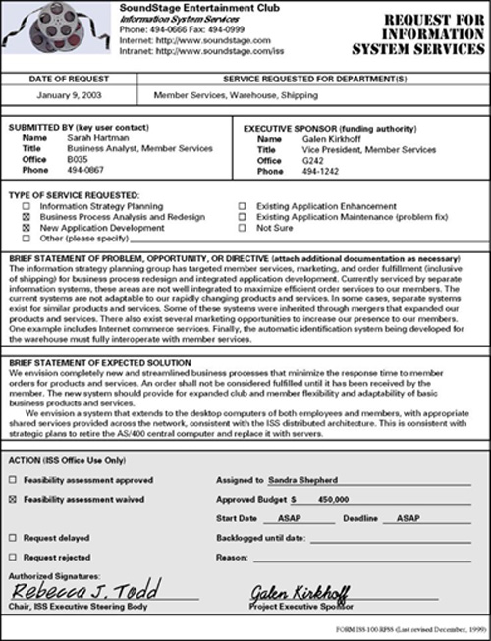

Slide 8
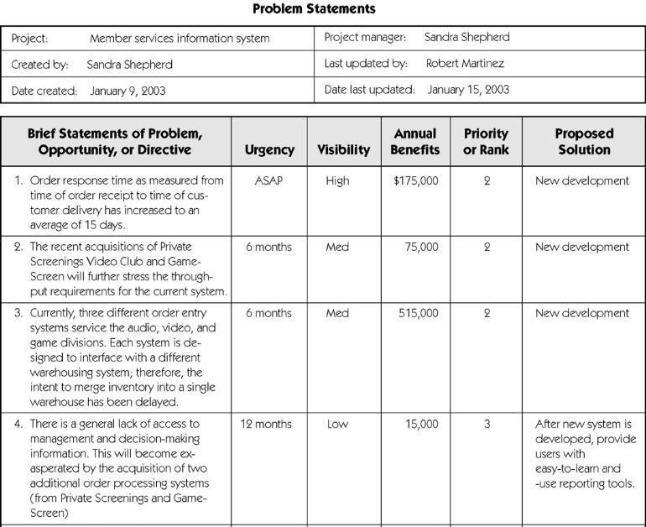

Slide 9
Task 1.2 Negotiate Scope
What types of data describe the system being studied?
What types of processes are included in the system being studied?
How must the system interface with the users, locations, and other systems?

Slide 10
Task 1.3 Assess Project Worthiness
Will solving the problems, exploiting the opportunities, or fulfilling the directives return enough value to offset the costs that will be incurred to develop the system?

Slide 11
Task 1.4 Develop Schedule and Budget
Preliminary Master Plan
  includes schedule and resource assignments for the entire project
Detailed Plan
  includes a detailed plan and schedule for the next phase of the project, the Problem Analysis Phase

Slide 12
Task 1.5 Communicate the Project Plan
Present and defend the project plan for approval to a Steering Committee, a group of primarily non-information systems executives and managers
Conduct a project kickoff event, facilitated jointly by the Executive Sponsor and the chosen Project Manager

Slide 13
Phase 2 Problem Analysis
Task 2.1 Understand the Problem Domain
Task 2.2 Analyze Problems and Opportunities
Task 2.3 Analyze Business Processes
Task 2.4 Establish System Improvement Objectives
Task 2.5 Update the Project Plan
Task 2.6 Communicate Findings and Recommendations

Slide 14
Task 2.1 Understand the Problem Domain
Knowledge (Data Model)
  List all the things about which the current system currently stores data
Processes (Decomposition Diagram)
  Define each business event for which a process is currently implemented
Communications (Context Diagram)
  Define all the locations that the current system serves and all the users at each of those locations

Slide 15
Task 2.2 Analyze Problems and Opportunities
Cause-and-Effect Analysis
  a technique in which problems are studied to determine their causes and effects

Slide 16
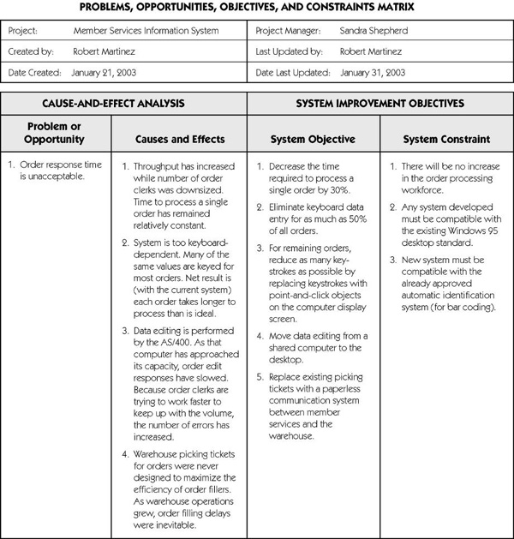

Slide 17
Task 2.3 Analyze
Business Processes
Appropriate for Business Process Redesign
  fact finding techniques
  facilitated team meetings
  process modeling techniques

Slide 18
Task 2.4 Establish System Improvement Objectives
Objective
  is a measure of success, something that is achievable if given sufficient resources
Constraint
  is something that will limit the flexibility in defining a solution to the objective, such as deadlines, budgets, technology, and policy

Slide 19
Task 2.5 Update the Project Plan
Re-evaluate the Project Scope
Should include a detailed plan for the Requirements Analysis Phase to follow

Slide 20
Task 2.6 Communicate Findings & Recommendations
Present the System Improvement Objectives
Obtain authority to continue, or ...
Adjust the scope, cost, and schedule, or ...
Cancel the project due to:
  lack of resources
  the problem not being as important as anticipated
  the costs exceeding the benefits

Slide 21
Phase 3 Requirements Analysis
Task 3.1 Identify Requirements
Task 3.2 Prioritize Requirements
Task 3.3 Update Project Plan
Task 3.4 Communicate Requirements Statement

Slide 22
Task 3.1 Identify Requirements
Functional Requirements
  a description of activities a system must provide
  e.g. inputs, outputs, processes, and stored data
Non-Functional Requirements
  a description of other features, characteristics, and constraints that define a satisfactory system
  e.g. performance, ease of use, costs, deadlines, training, quality, and security

Slide 23
Task 3.2 Prioritize Requirements
Timeboxing
  a technique that delivers systems functionality and requirements through versioning
Mandatory Requirements
  must be fulfilled by the initial system version
Desirable Requirements
  should be ranked to be included in subsequent versions

Slide 24
Task 3.3 Update Project Plan
Adjust the schedule, budget, or scope if the system is larger than expected
Reduce the scope to meet a deadline or increase the budget to get the job done
Secure approval to continue the project into the next phase

Slide 25
Task 3.4 Communicate
Requirements Statement
Project Description
Objectives & Constraints
Data Models & Requirements
Process Models & Requirements
Network Models & Requirements
Prototype Screens & Reports
Design Phase Plan & Schedule

Slide 26
Phase 4 Logical Design
Task 4.1a Structure Functional Requirements
Task 4.1b Prototype Functional Requirements
Task 4.2 Validate Functional Requirements
Task 4.3 Define Acceptance Test Cases

Slide 27
Task 4.1a Structure
Functional Requirements
Draw system models to illustrate the functional requirements using data, process, or object models
Supplement models with detailed logical specifications that describe data attributes, business rules and policies

Slide 28
Task 4.1b Prototype
Functional Requirements
Requirements that are difficult to express verbally can be facilitated by prototyping, a method that allows users to recognize requirements by visualizing them.

Slide 29
Task 4.2 Validate
Functional Requirements
Users make clarifications and identify errors or omissions to ensure that requirements are complete and correct.

Slide 30
Task 4.3 Define
Acceptance Test Cases
Models and prototypes define the processing requirements, data rules, and business rules, that are used to define test cases that in turn are used to test programs for correctness.

Slide 31
Phase 5 Decision Analysis
Task 5.1 Identify Candidate Solutions
Task 5.2 Analyze Candidate Solutions
Task 5.3 Compare Candidate Solutions
Task 5.4 Update Project Plan
Task 5.5 Recommend a Solution

Slide 32
Task 5.1 Identify Candidate Solutions
Sources
System owners and users
Analysts, designers, consultants and other IT professionals
May be limited by predefined, approved technology architecture such as Windows NT

Slide 33
Task 5.2 Analyze Candidate Solutions
Technical Feasibility
  Is the solution technically practical?
Operational Feasibility
  Will the solution fill the user’s requirements?
Economic Feasibility
  Is the solution cost-effective?
Schedule Feasibility
  Can the solution be implemented within an acceptable time period?

Slide 34
Task 5.3 Compare Candidate Solutions
Feasibility Analysis Matrix
  allows side-by-side comparisons
  matches each candidate to feasibility criteria
  uses weights to allocate points that determine candidate ranking

Slide 35
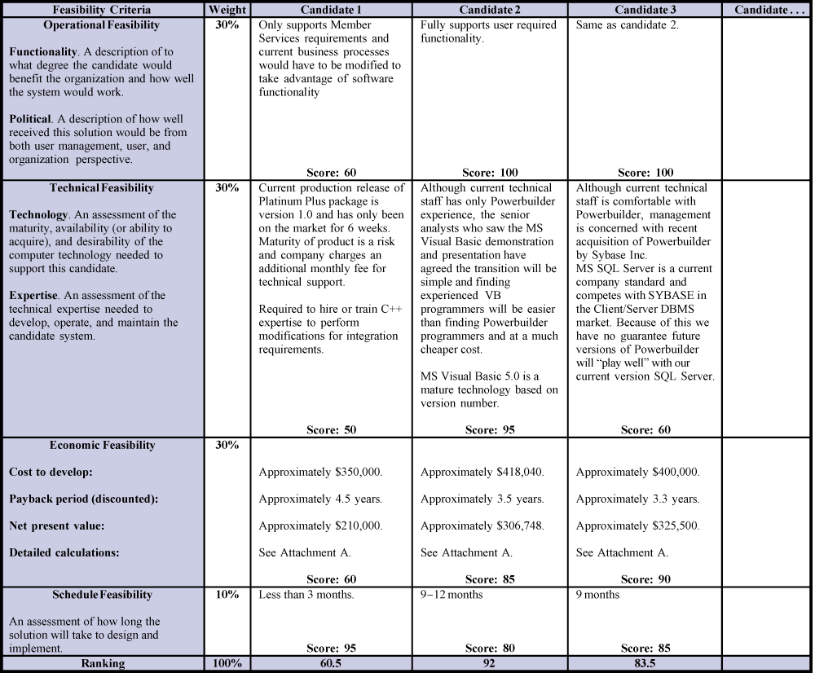

Slide 36
Task 5.4 Update Project Plan
Should now include detailed plan for the System Design Phase that will follow

Slide 37
Task 5.5 Recommend a Solution
The System Proposal
Report, presentation, or an inspection by an auditor or peer group (walk-through)
Should include:
  Introduction
  Tools and techniques used
  Information systems requirements
  Alternative solutions & feasibility analysis
  Recommendations

